Slide 1
DWDM
Unit 5.1

Slide 2
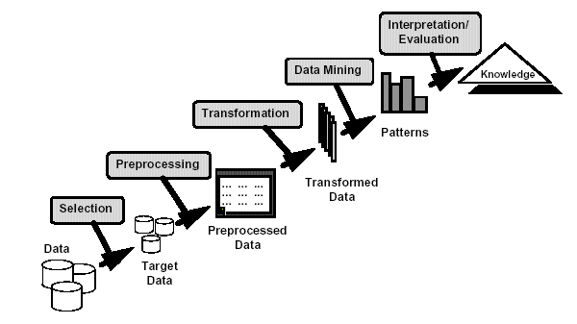
What is Data Mining?
Many Definitions
Non-trivial extraction of implicit, previously unknown and potentially useful information from data
Exploration & analysis, by automatic or semi-automatic means, of large quantities of data in order to discover meaningful patterns

Slide 3
What is (not) Data Mining?
What is not Data Mining? (Trivial)
Look up phone number in phone directory
Query a Web search engine for information about “Amazon”
What is Data Mining? (Non Trivial)
Certain names are more prevalent in certain New Road locations [classification]
Group together similar documents returned by search engine according to their context (e.g. Amazon rainforest, Amazon.com) [clustering]

Slide 4
Why Mine Data? Commercial Viewpoint
Lots of data is being collected and warehoused
Web data, e-commerce
purchases at department/ grocery stores
Bank/Credit Card transactions
There is often information “hidden” in the data that is not readily evident
Human analysts may take weeks to discover useful information
Much of the data is never analyzed at all

Slide 5
Why Mine Data? Scientific Viewpoint
Data collected and stored at enormous speeds (GB/hour)
Traditional techniques infeasible for raw data
Data mining may help scientists
in classifying and segmenting data
in Hypothesis Formation

Slide 6
Origins of Data Mining
Draws ideas from machine learning/AI, pattern recognition, statistics, and database systems
Traditional Techniques may be unsuitable due to
Enormity of data
High dimensionality of data
Heterogeneous, distributed nature of data
Velocity (faster generation of
data)
Statistics/ AI
Machine Learning/
Pattern Recognition
Data Mining
Database systems

Slide 7
Data Mining Tasks (Functionalities)
Concept/Class Description
Mining Frequent Patterns, Associations, and Correlations
Classification
Prediction
Cluster Analysis
Outlier Analysis
Evolution Analysis

Slide 8
Data Mining Tasks (Functionalities)...
Concept/Class Description
These descriptions can be derived via data characterization or data discrimination.
Data characterization: It is a summarization of the general characteristics or features of a target class of data. Example: summarizing the characteristics of customers who spend more than $5,000 in a month.
Data discrimination: It is a comparison of the general features of target class data objects with the general features of objects from one or a set of contrasting classes. Example: Buying Customer Vs. Non Buying Customer.

Slide 9
Classification: Definition
Given a collection of records (training set ), each record containing a set of attributes where one of the attributes is the class, find a model for class attribute as a function of the values of other attributes.
Goal: previously unseen records should be assigned a class as accurately as possible.
A test set is used to determine the accuracy of the model. Usually, the given data set is divided into training and test sets, with training set used to build the model and test set used to validate it.

Slide 10
Classification Example
categorical
categorical
continuous
class
Test
Set
Learn
Classifier
Training
Set
Model

Slide 11
Classification: Application 1
Direct Marketing
Goal: Reduce cost of mailing by targeting a set of consumers likely to buy a new cell-phone product.
Approach:
Use the data for a similar product introduced before.
We know which customers decided to buy and which decided otherwise. This {buy, don’t buy} decision forms the class attribute.
Collect various demographic, lifestyle, and company-interaction related information about all such customers.
Type of business, where they stay, how much they earn, etc.
Use this information as input attributes to learn a classifier model.

Slide 12
Classification: Application 2
Fraud Detection
Goal: Predict fraudulent cases in credit card transactions.
Approach:
Use credit card transactions and the information on its account-holder as attributes.
When does a customer buy, what does he buy, how often he pays on time, etc.
Label past transactions as fraud or fair transactions. This forms the class attribute.
Learn a model for the class of the transactions.
Use this model to detect fraud by observing credit card transactions on an account.

Slide 13
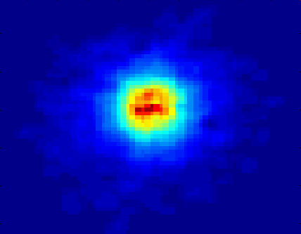
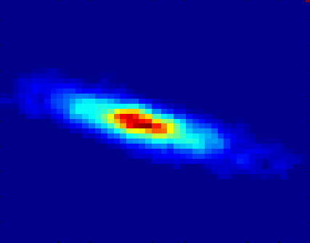
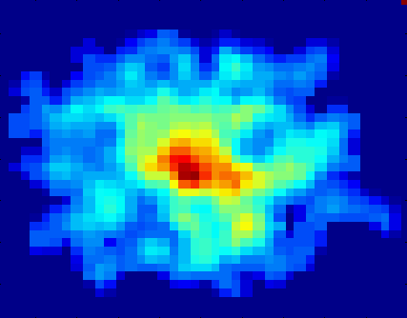
Classification: Application 3
Galaxy Classification
Early
Class:
Stages of Formation
Attributes:
Image features,
Characteristics of light waves received, etc.
Intermediate
Late
Data Size:
72 million stars, 20 million galaxies
Object Catalog: 9 GB
Image Database: 150 GB

Slide 14
Clustering Definition
Given a set of data points, each having a set of attributes, and a similarity measure among them, find clusters such that
Data points in one cluster are more similar to one another.
Data points in separate clusters are less similar to one another.
Similarity Measures:
Euclidean Distance if attributes are continuous.
Other Problem-specific Measures.

Slide 15
Illustrating Clustering
Euclidean Distance Based Clustering in 3-D space.
Intracluster distances
are minimized
Intercluster distances
are maximized

Slide 16
Clustering: Application 1
Market Segmentation:
Goal: subdivide a market into distinct subsets of customers where any subset may conceivably be selected as a market target to be reached with a distinct marketing mix.
Approach:
Collect different attributes of customers based on their geographical and lifestyle related information.
Find clusters of similar customers.
Measure the clustering quality by observing buying patterns of customers in same cluster vs. those from different clusters.

Slide 17
Clustering: Application 2
Document Clustering:
Goal: To find groups of documents that are similar to each other based on the important terms appearing in them.

Slide 18
Illustrating Document Clustering
Clustering Points: 3204 Articles of HimalyanTimes.
Similarity Measure: How many words are common in these documents (after some word filtering).

Slide 19
Clustering of Stock Data
Observe Stock Movements every day.
Clustering points: Stock-{UP/DOWN}
Similarity Measure: Two points are more similar if the events described by them frequently happen together on the same day.

Slide 20
Association Rule Discovery: Definition
Given a set of records each of which contain some number of items from a given collection;
Produce dependency rules which will predict occurrence of an item based on occurrences of other items.
Rules Discovered:
{Milk} --> {Coke}
{Diaper, Milk} --> {Beer}

Slide 21
Association Rule Discovery: Application 1
Marketing and Sales Promotion:
Let the rule discovered be
{Bagels, … } --> {Potato Chips}
Potato Chips as consequent => Can be used to determine what should be done to boost its sales.
Bagels in the antecedent => Can be used to see which products would be affected if the store discontinues selling bagels.
Bagels in antecedent and Potato chips in consequent => Can be used to see what products should be sold with Bagels to promote sale of Potato chips!

Slide 22
Association Rule Discovery: Application 2
Supermarket shelf management:
Goal: To identify items that are bought together by sufficiently many customers.
Approach: Process the point-of-sale data collected with barcode scanners to find dependencies among items.
A classic rule --
If a customer buys diaper and milk, then he is very likely to buy beer.
So, don’t be surprised if you find six-packs stacked next to diapers!

Slide 23
Sequential Pattern Discovery: Definition
Given is a set of objects, with each object associated with its own timeline of events, find rules that predict strong sequential dependencies among different events.
Rules are formed by first discovering patterns. Event occurrences in the patterns are governed by timing constraints.
(A B) (C) (D E)
(A B) (C) (D E)
<= xg
>ng
<= ws
<= ms

Slide 24
Regression
Predict a value of a given continuous valued variable based on the values of other variables, assuming a linear or nonlinear model of dependency.
Greatly studied in statistics, neural network fields.
Examples:
Predicting sales amounts of new product based on advertising expenditure.
Predicting wind velocities as a function of temperature, humidity, air pressure, etc.
Time series prediction of stock market indices.

Slide 25
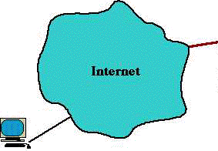
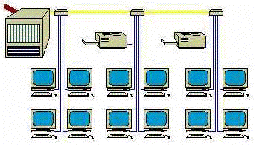
Deviation/Anomaly Detection
Detect significant deviations from normal behavior
Applications:
Credit Card Fraud Detection
Network Intrusion Detection

Slide 26
Outlier Analysis
A database may contain data objects that do not comply with the general behavior or model of the data.
These data objects are outliers.
Example: fraudulent usage of credit cards

Slide 27
Evolution Analysis
Data evolution analysis describes and models regularities or trends for objects whose behavior changes over time.
Example: stock market (time-series) data

Slide 28
Challenges of Data Mining
Developing a unifying theory of data mining
Scaling up for high dimensional data and high speed data streams
Mining sequence data and time series data
Mining complex knowledge from complex data
Data mining in a network setting
Distributed data mining and mining multi-agent data
Data mining for biological and environmental problems
Data Mining process-related problems
Security, privacy and data integrity
Dealing with non-static, unbalanced and cost-sensitive data

Slide 29
Issues in Data Mining
Mining methodology and user interaction issues:
Mining different kinds of knowledge in databases
Interactive mining of knowledge at multiple levels of abstraction
Incorporation of background knowledge
Handling noisy or incomplete data
Pattern evaluation
Performance Issues:
Efficiency and scalability of data mining algorithms
Parallel, distributed, and incremental mining algorithms

Slide 30
Issues in Data Mining
Database diversity issues:
Handling of relational and complex types of data
Mining information from heterogeneous databases and global information systems

Slide 31
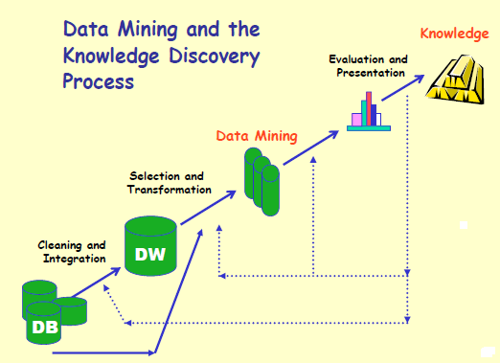
Stages of Knowledge Discovery in Database (KDD)

Slide 32
Stages of Knowledge Discovery in Database (KDD)…
Data cleaning: It removes noise and inconsistent data
Data integration: This combines data from multiple data sources
Data selection: Data relevant to the analysis task are retrieved from the database
Data transformation: Data are transformed or consolidated into forms appropriate for mining by performing summary or aggregation operations.

Slide 33
Stages of Knowledge Discovery in Database (KDD)…
Data mining: an essential process where intelligent methods are applied in order to extract data patterns
Pattern evaluation: Identifies the truly interesting patterns representing knowledge based on some interestingness measures.
Knowledge presentation: Knowledge representation techniques are used to present the mined knowledge to the user.

Slide 34
Setting up KDD environment
Support for Extremely Large Data Set: Data mining deals with billions of records. Thus fast and flexible way of storing and handling such large volume of data is required along with capacity of storing intermediate results.
Support Hybrid Learning: Learning can be divided into three categories: Classification, Knowledge engineering, & problem solving. Complex data mining projects needs hybrid learning algorithms that possess capabilities of all three categories.

Slide 35
Setting up KDD environment…
Establish a Data Warehouse: Data mining mainly depends upon availability and analysis of historic data and hence establishing data warehouse is important for this.
Introduce Data Cleaning Facility: If data stored in databases contains noise, data processing suffers from pollution. Thus data cleaning facility is necessary to avoid such pollution.

Slide 36
Setting up KDD environment…
Facilitate Working with Dynamic Coding: A KDD Environment should enable the user to experiment with different coding schemes. It must keep the track of genealogy of different samples and tables as well as the semantics and transformations of the different attributes are vital.
Beware of False Predictors: If the results are too good to be true, you probably have found false predictors.
Verify Result: Examine the results carefully and repeat and refine the knowledge discovery process until you are confident.

Slide 37
Application of Data Mining
Market Analysis and Management: Target marketing, customer relation management, market basket analysis, cross selling, market segmentation, Find clusters of customers who share the same characteristics: interest, income level, spending habits, etc. Determine customer purchasing patterns over time
Risk Analysis and Management: Forecasting, customer retention, improved underwriting, quality control, competitive analysis, credit scoring.

Slide 38
Application of Data Mining…
Internet Web Surf-Aid: Surf-Aid applies data mining algorithms to Web access logs for market-related pages to discover customer preference and behavior pages, analyzing effectiveness of Web marketing, improving Web site organization.
Social Web and Networks: User-centric applications like blogs, wikis and Web communities generate a lot of structured and semi-structured information where data mining can be used to explain and predict the evolution of social networks, personalized search for social interaction, user behavior prediction etc.

Slide 39
Application of Data Mining…
Fraud Detection and Management: Use historical data to build models of fraudulent behavior and use data mining to help identify similar instances. For example, detect suspicious money transactions.
Sports: Data mining can be used to analyze shots & fouls of different athletes, their weaknesses and helps athletes to assist in improving their games.
Space Science: Data mining can be used to automate the analysis image data collected from sky survey with better accuracy.

